Slide 1
SOA Concepts

Slide 2
Agenda
What is SOA?
Introducing SOA terminologies
What is Web Service?
Producers and Consumers
Key Pieces of Web Services
SOAP Protocol
WSDL File
Consuming SOAP Web services
Producing SOAP Web services
Using SOAP UI tool

Slide 3
What is SOA?
Service Oriented Architecture
Architecture oriented towards Service ☺
Application components provide services to other components via a communications protocol, typically over a network.
Example:
A function offers itself to other functions
Could be from different applications

Slide 4
What is SOA?
Service Oriented Architecture
Developing loosely coupled distributed applications
Collection of many services in the network
Services can communicate with other services and can exchange data.
Earlier SOA was based on ORBs and DCOM
These days, SOA is based on Web Services

Slide 5
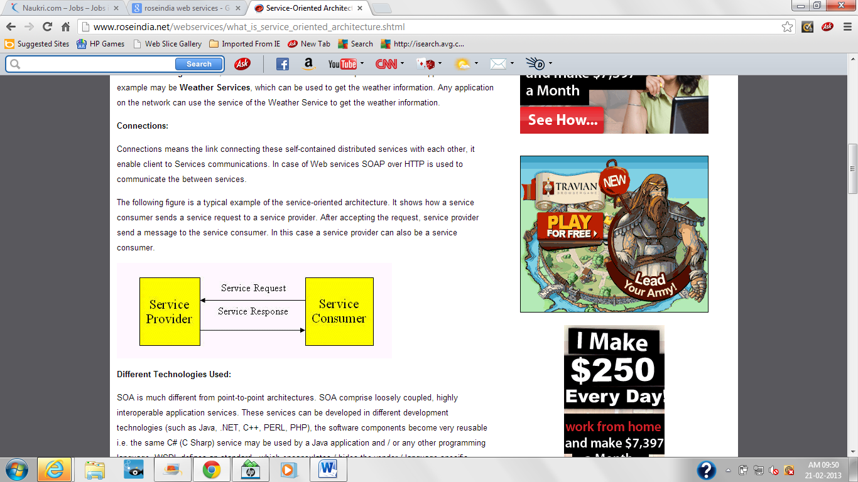
Services and Connections

Slide 6
Some Terminologies
Service:
A self-contained, stateless business function which accepts one or more requests and returns one or more responses through a well-defined, standard interface.

Slide 7
Some Terminologies
Stateless:
Not depending on any pre-existing condition.
Services should not depend on the condition of any other service.
Since statelss, service consumers can sequence (orchestrate) them into numerous flows (sometimes referred to as pipelines) to perform application logic.

Slide 8
Some Terminologies
Service Provider:
The function which performs a service in response to a request from a consumer.

Slide 9
Some Terminologies
Service Consumer:
The function which consumes the result of a service supplied by a provider.

Slide 10
Some Terminologies
Service Discovery:
Service oriented architecture relies on the ability to identify services and their capabilities. Therefore, a SOA depends on a directory which describes the services available in its domain.

Slide 11
Why SOA?
Platform independence
Companies can use software and hardware of their choices.
No vendor lock-in
Enables incremental development, deployment and maintenance.
Companies can use existing s/w and use SOA to build applications without replacing existing app.

Slide 12
Web Services
A function or any business processing logic
Self-contained
Complete
Does not depend on the state of other services. Examples are:
Loan Processing Services, which can be self-contained unit for processing Loan application.
Weather Services, which can be used to get the weather information. Any application on the network can use these services.

Slide 13
Service Oriented Architecture (SOA)
Under SOA, Web services is used to implement an architecture in which the basic unit of communication is a message, rather than an operation.
This is often referred to as "message-oriented" services.

Slide 14
Producer and Consumer
Using Web services:
a Web service developer aka producer can use any language he/she wishes
a Web service consumer can use standard HTTP to invoke methods a Web service provides.
Bottom line: True language and platform integration/independence.

Slide 15
Types of Web Services
SOAP
Simple Object Access Protocol
REST
REpresentational State Transfer

Slide 16
Elements of Web Services
SOAP
XML based protocol
Used to communicate information with applications over HTTP
Initiating conversations with a UDDI service
REST
HTTP based
HTTP Method types (GET, POST, PUT, DELETE)
URI (end points)

Slide 17
Elements of SOAP Web Services
UDDI
Universal Description, Discovery and Integration
Web based distributed directory (like yellow pages or phone book)
Defines a registry service (remember rmi registry?)
Service providers use UDDI to advertise the services
Service consumers use UDDI to discover services

Slide 18
SOAP: WSDL
WSDL
Web Services Description Language
Pronounced as VISDEL
Proposed standard for how a Web service is described
XML based service IDL (Interface Definition Language)
Defines what services are available in its web service, defines the methods, parameter names, parameter data types and return data types

Slide 19
Steps involved in implementing SOAP Web Services
A service provider (SP) creates a web service
The SP uses WSDL to describe the service
The SP registers the service in a UDDI registry
The requesting service or user writes an application to access the registered service using SOAP in the case of UDDI.
Data and messages are exchanged as XML over HTTP

Slide 20
Web Services
The World Wide Web Consortium (W3C) has defined the web services.
According to W3C, “Web Services are the message-based design frequently found on the Web and in enterprise software.
The Web of Services is based on technologies such as HTTP, XML, SOAP, WSDL, and others.”

Slide 21
Technologies and Tools
MicroSoft technologies:
C#
.NET Framework
MicroSoft SQL Server
IDE: Visual Studio
Oracle technologies:
Java Servlets
JSP
EJB
JEE Framework
IDE: Eclipse, Forte, JDeveloper etc.

Slide 22
Web Service implementations
Apache axis is the widely used implementation for the Web Service for SOAP
Jersey is one implementation of Web Service for REST

Slide 23
Demo 1
How to consume SOAP web services produced by somebody?
Let's see how to consume the web services from the following URLs.
http://www.dataaccess.com/webservicesserver/numberconversion.wso?WSDL
http://www.dneonline.com/calculator.asmx?wsdl

Slide 24
Demo 2
How to produce SOAP web services?
Create a dynamic web project
Define a simple Java class
Define a method that returns a String
Create a web service out of it
Deploy and run on Apache tomcat server
Access the generated wsdl file
Write the test client to consume it.

Slide 25
About WSDL
XML-based protocol for information exchange
WSDL definitions describe how to access a web service and what operations it will perform.
The wsdl file for our project can be viewed as:
http://localhost:8080/MyFirstWebProjectGuru/services/Hello?wsdl

Slide 26
About WSDL
<wsdl:service name> gives us the name of the web service
We deduce the portType name from this
It gives us the name of the operation (method name)
wsdl:types hints us the variable data type that the method returns
Generally, this will be provided by other project team

Slide 27
WSDL Binding
The <binding> element provides specific details on how a portType operation will actually be transmitted over the wire.
The bindings can be made using HTTP GET, HTTP POST, or SOAP.
Basically, it specifies what protocol is used
For SOAP protocol, the binding is <soap:binding>, and the transport is SOAP messages on top of HTTP protocol.

Slide 28
SOAP Message
XML Document that contains:
Envelope
Header
Body
Fault (In case of errors)
These elements are maintained and mentioned in the following schema
http://schemas.xmlsoap.org/soap/envelope

Slide 29
About SOAP UI
It's open-source API testing tool
Use this to send and receive SOAP messages
In case of SOAP, you need to provide the URL for wsdl file (refer the demo)
You can use this tool for testing REST APIs too
In case of REST API, you should provide the REST endpoints (will see a demo)

Slide 30
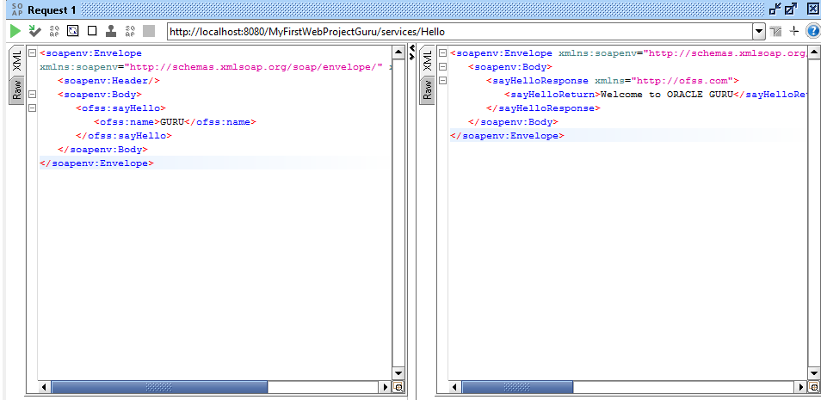
SOAP Message in SOAP UI

Slide 31
Thank You

